Slide 1

EDA on Travel Triangle Website
PRESENTED BY :
ADITI PATIL

Slide 2

About me
Name : Aditi Patil
Education : Bachelor of technology (Computer science and engineering)
LinkedIn
Github

Slide 3


Problem Statement :
Travel data is very large
Hard to understand customer choices
Difficult to compare packages
Objective :
Find popular destinations
Analyze price trends
Understand customer behavior

Slide 4
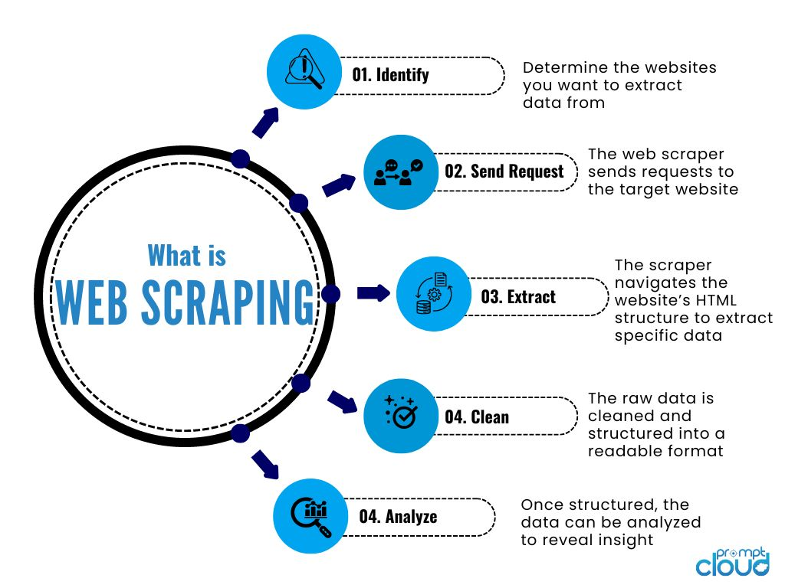

Slide 5
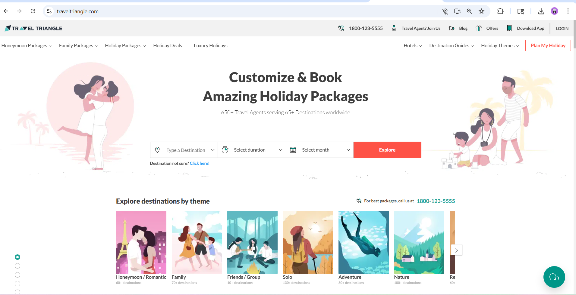
First look of website

Slide 6
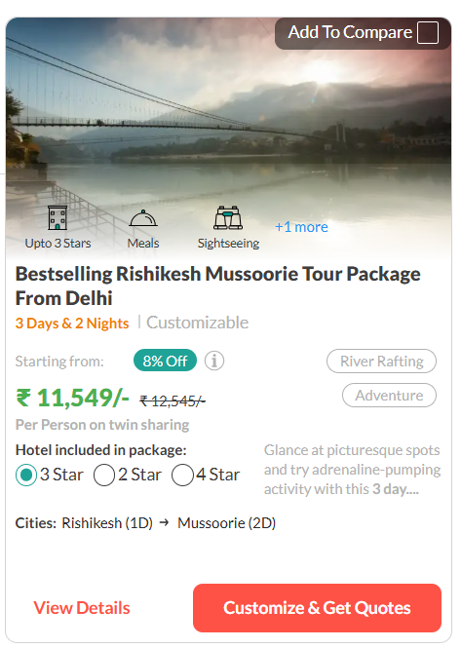
EXTRACTING THE CONTENT FORM
WEBSITE USED :
Provides travel packages
Includes destination, price, days, package type
Helps users plan trips
Covers multiple destinations
Package Name
Trip Duration
Discount
Original Price
Discounted Price

Slide 7
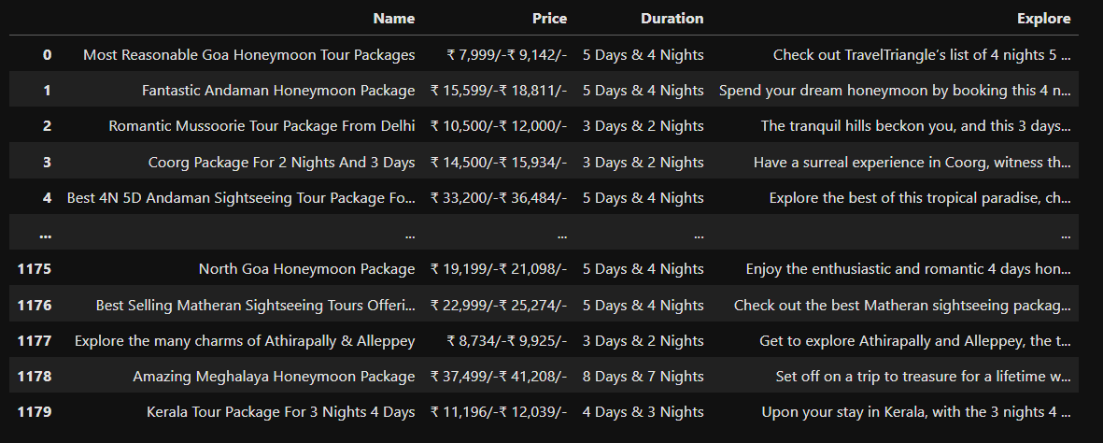
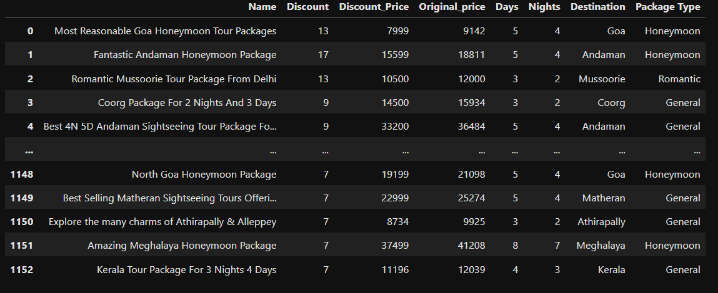
Raw Data
New Dataframe

Slide 8
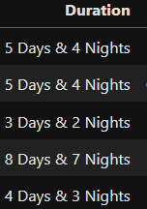
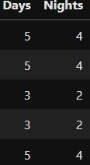
Regex Used
Regex (Regular Expression) is used to find and extract specific patterns from text data.
In our dataset, the Duration column contains text like:
“4 Days & 3 Night’’
But for analysis, we need only the numbers:
Days = 4
Nights = 3
So, Regex helps us extract these numbers automatically.
r'(\d+)\s*Days\s*&\s*(\d+)\s*Night'

Slide 9
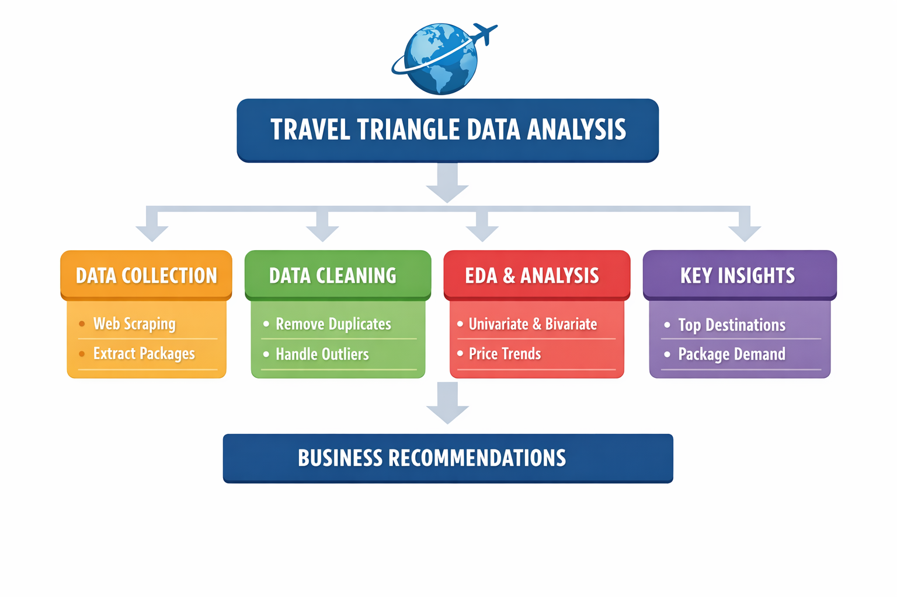

Slide 10
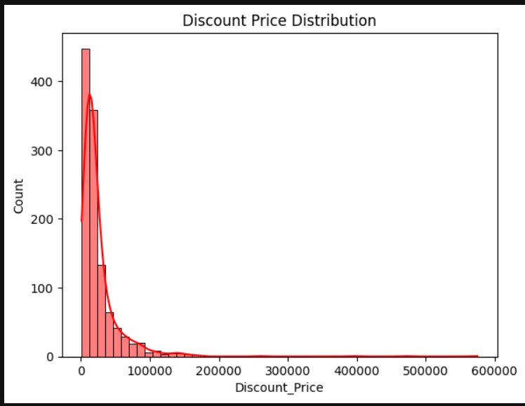
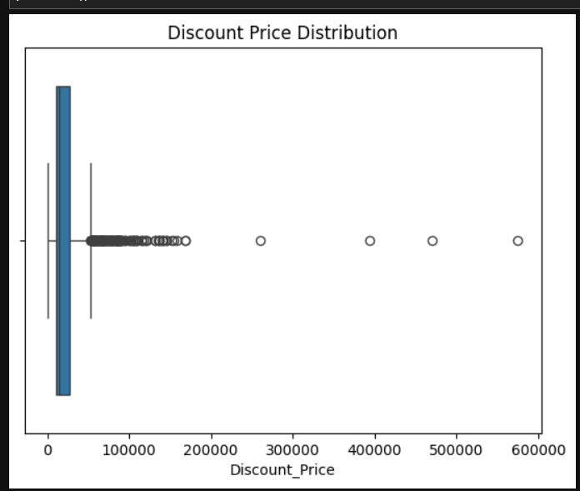
UNIVARIATE NUMERICAL ANALYSIS
Most packages range between ₹5,000 – ₹30,000
Data is slightly right-skewed (few high-price values)
Majority of data is concentrated around ₹10,000 – ₹20,000
Some outliers above ₹50,000+ (premium packages)

Slide 11
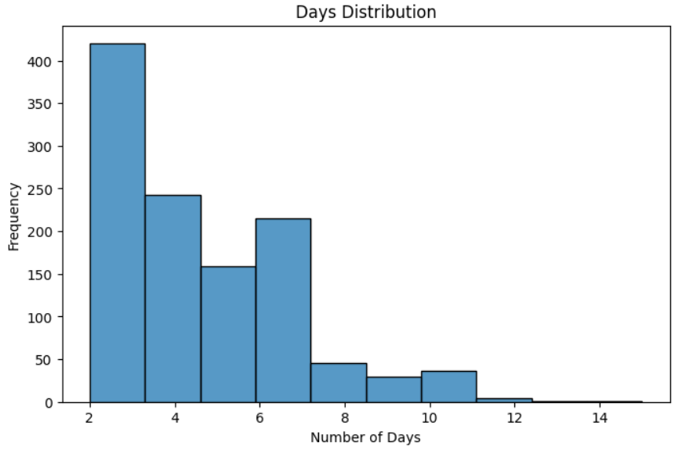
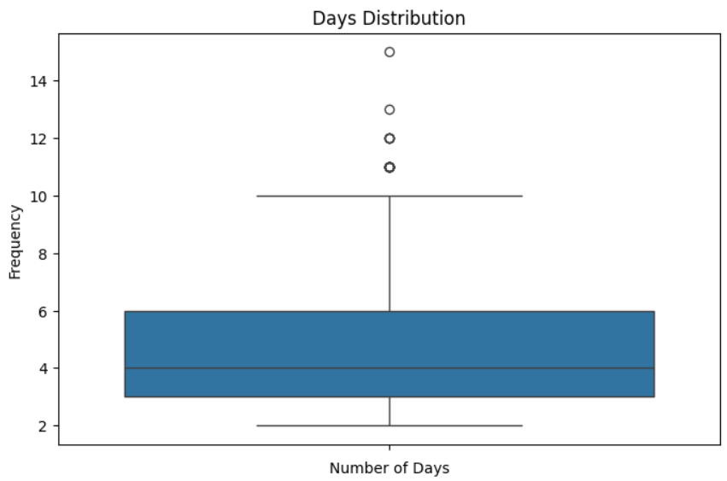
UNIVARIATE NUMERICAL ANALYSIS
Most trips are between 3 – 7 days
Few trips go beyond 10 days (outliers)
Peak around 4 – 5 days

Slide 12
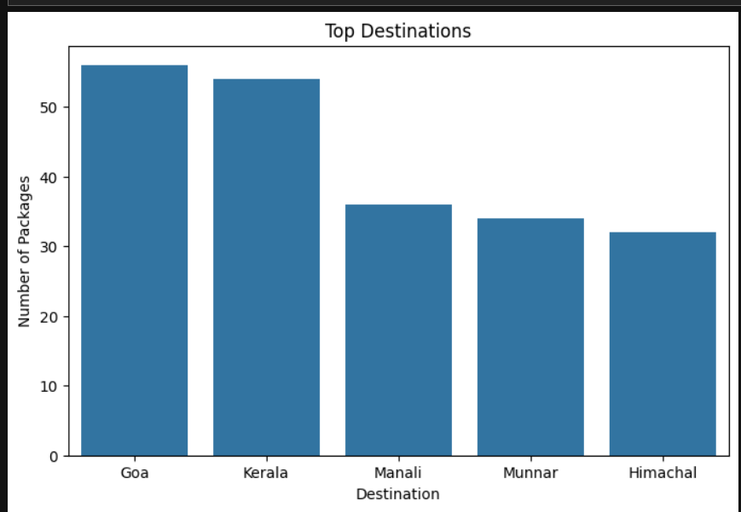
UNIVARIATE CATEGORICAL ANALYSIS
Goa → Highest number of packages
Kerala → Popular for nature & backwater tourism
Manali → Very popular hill station
Munnar → Famous for scenic beauty and tea gardens
Himachal Pradesh → Preferred hill destination
These destinations cover major share of dataset (~50–60%)

Slide 13
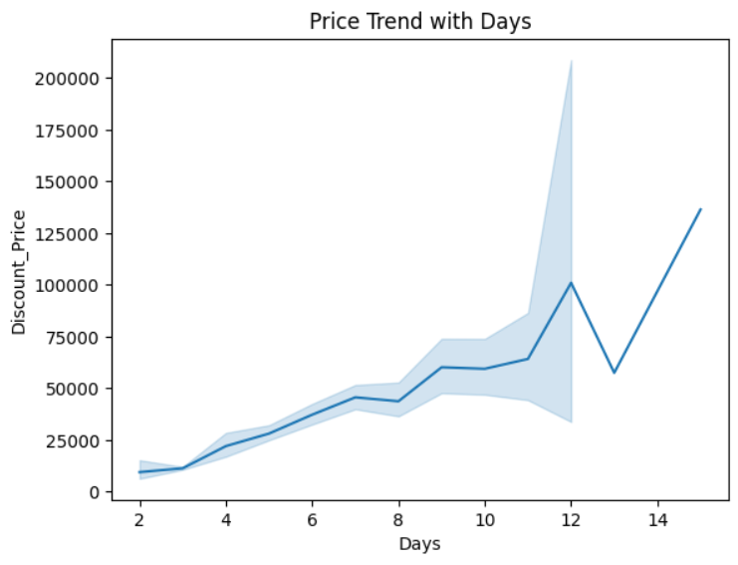
BIVARIATE ANALYSIS
Price increases as number of days increases
Strong positive relationship between duration and cost
Longer trips are significantly more expensive
Duration is a key factor affecting package pricing

Slide 14
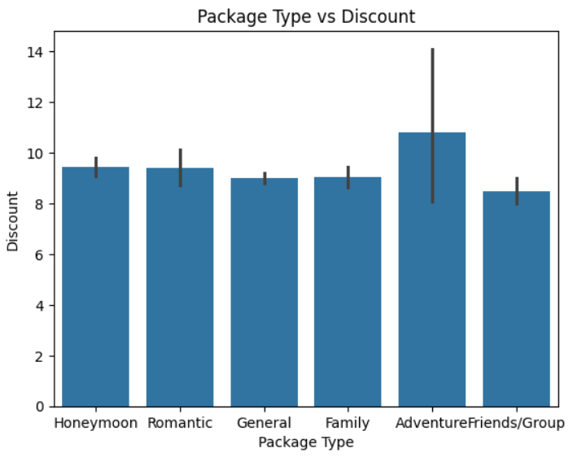
BIVARIATE ANALYSIS
Discount varies across different package types
Some package types offer higher average discounts
Premium packages may have higher discount values
Pricing and discount strategy depends on package category

Slide 15
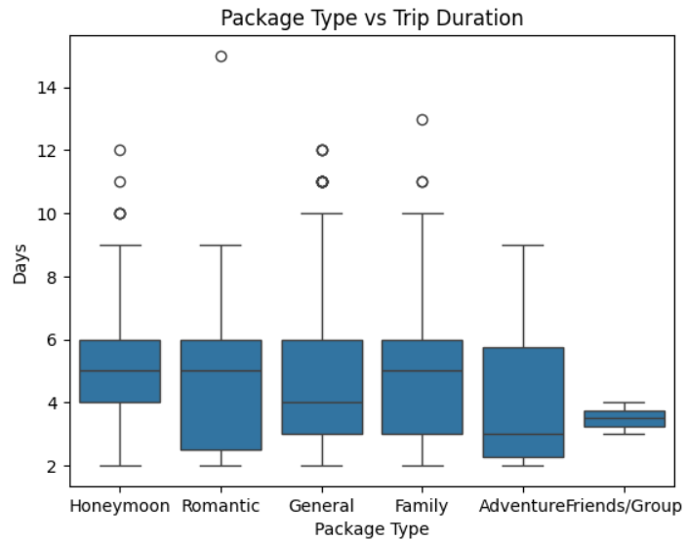
BIVARIATE ANALYSIS
Trip duration varies across different package types
Some package types offer longer duration trips
Most trips are concentrated within a common range
Few outliers represent very long trips

Slide 16
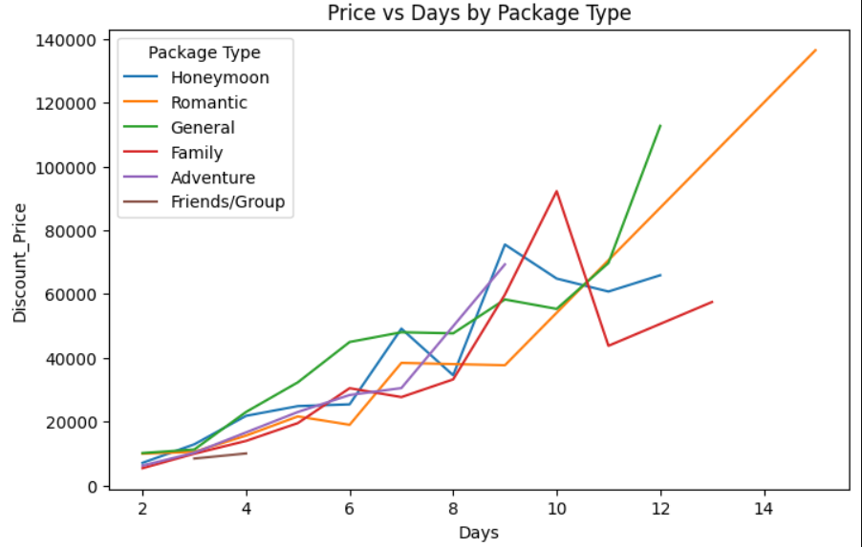
MULTIVARIATE ANALYSIS
Price increases with number of days across all package types
Clear positive relationship between duration and price
Different package types show variation in pricing levels
Some package types are consistently more expensive

Slide 17
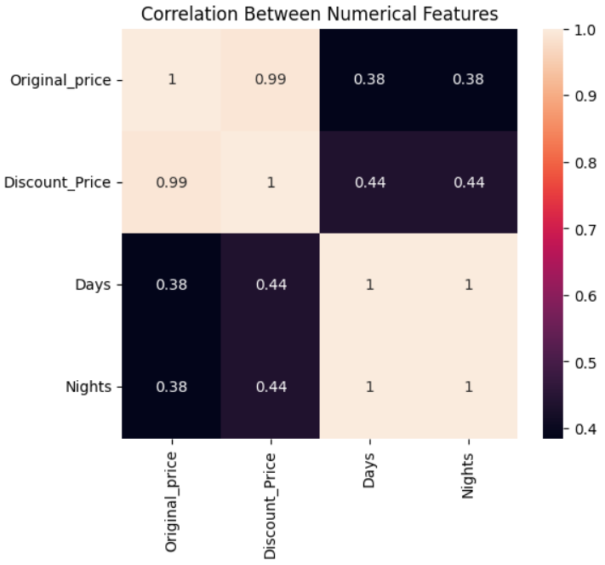
MULTIVARIATE ANALYSIS
Near-perfect correlation (~0.99) between Original Price and Discount Price
Indicates a consistent and standardized discount strategy
Perfect correlation (1.0) between Days and Nights shows data redundancy
Trip duration shows moderate positive correlation with price
Other factors like destination or hotel type also influence pricing

Slide 18
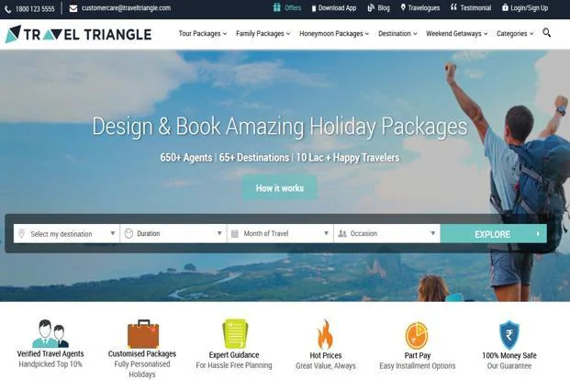
KEY INSIGHT
Top destinations: Goa, Manali, Kerala, Munnar (~50% share)
Most prices fall in ₹10,000 – ₹25,000 range
Trips are mostly short (3–7 days)
Premium segment exists but is small

Slide 19

Conclusion
Customers prefer short and affordable trip
Price is strongly affected by duration
Few destinations dominate market
Data helps improve pricing and marketing strategy

Slide 20

THANK YOU

